Slide 1
Project “Adjustment of Rokiskis Manour House to the needs of tourism”. Total value-7,2 million Eur.

Slide 2
Project objectives:
►To implement the reconstruction works, partial regenerative works for the rest of non-reconstructed buildings and the park, and adjust them for the needs of public tourism;
►To create modern complex of tourism service: museum, halls for exhibits, concerts, theatre, educational premices, crafts center, guest rooms and other service for tourists;
►To promote the development of small and medium business, creation of new jobs, increase the private investments to the region.

Slide 3
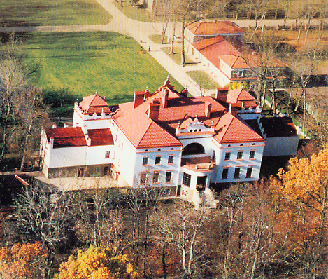
Project activities:
Reconstruction of Rokiskis Manour House buildings and the park, and adjustment to the needs of tourism:

Slide 4
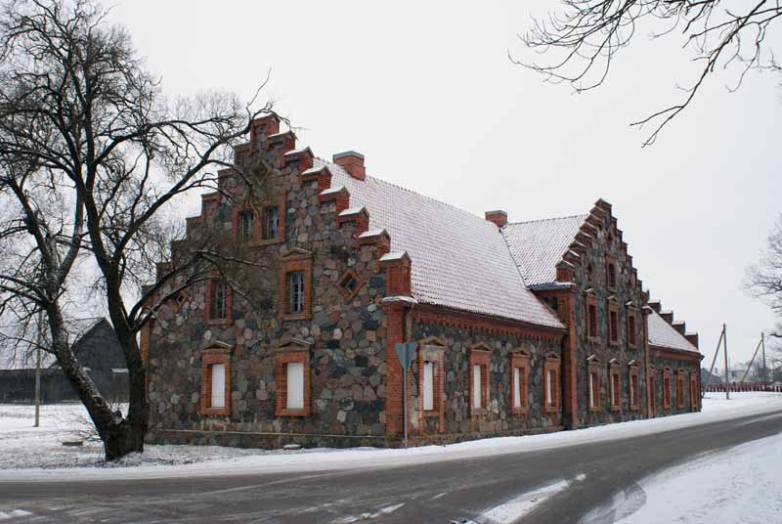
Farm-hand building No.1 (676,28 sq.m) reconstruction and adjustment to the center of exhibitions, cultural heritage and education;

Slide 5
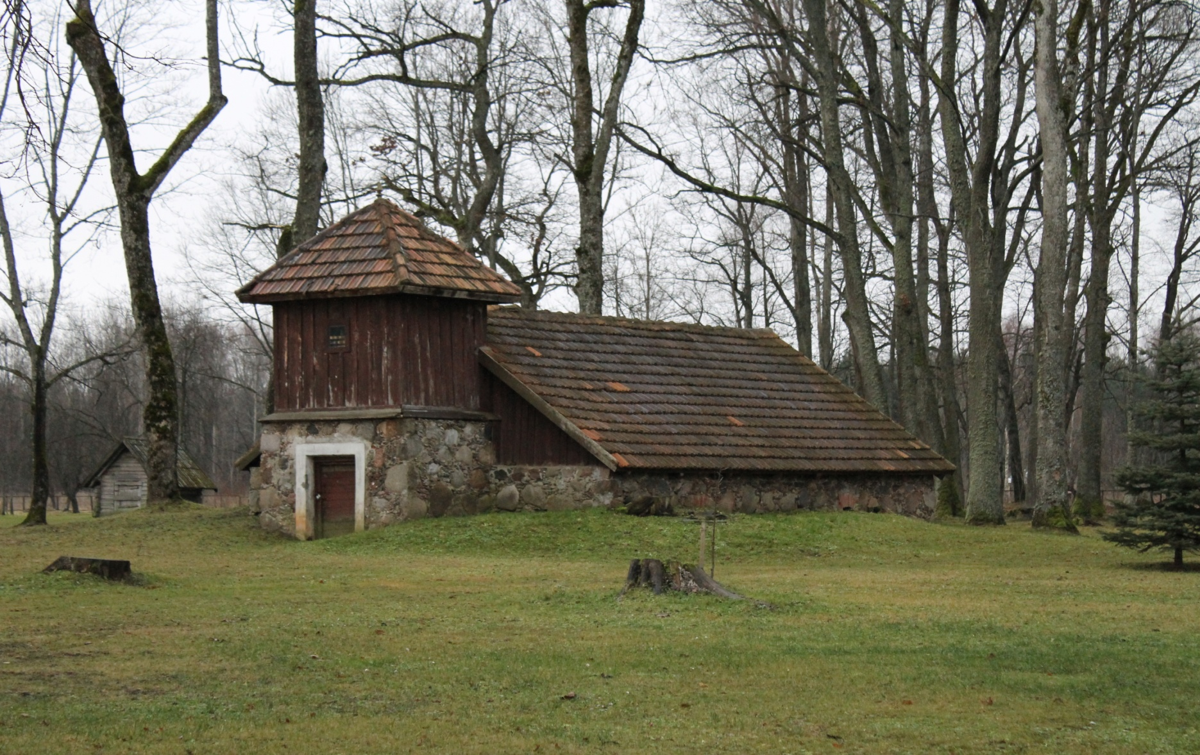
Reconstruction of icehouse (38,34 sq.m) and adjustment to the exposition of old crafts;

Slide 6
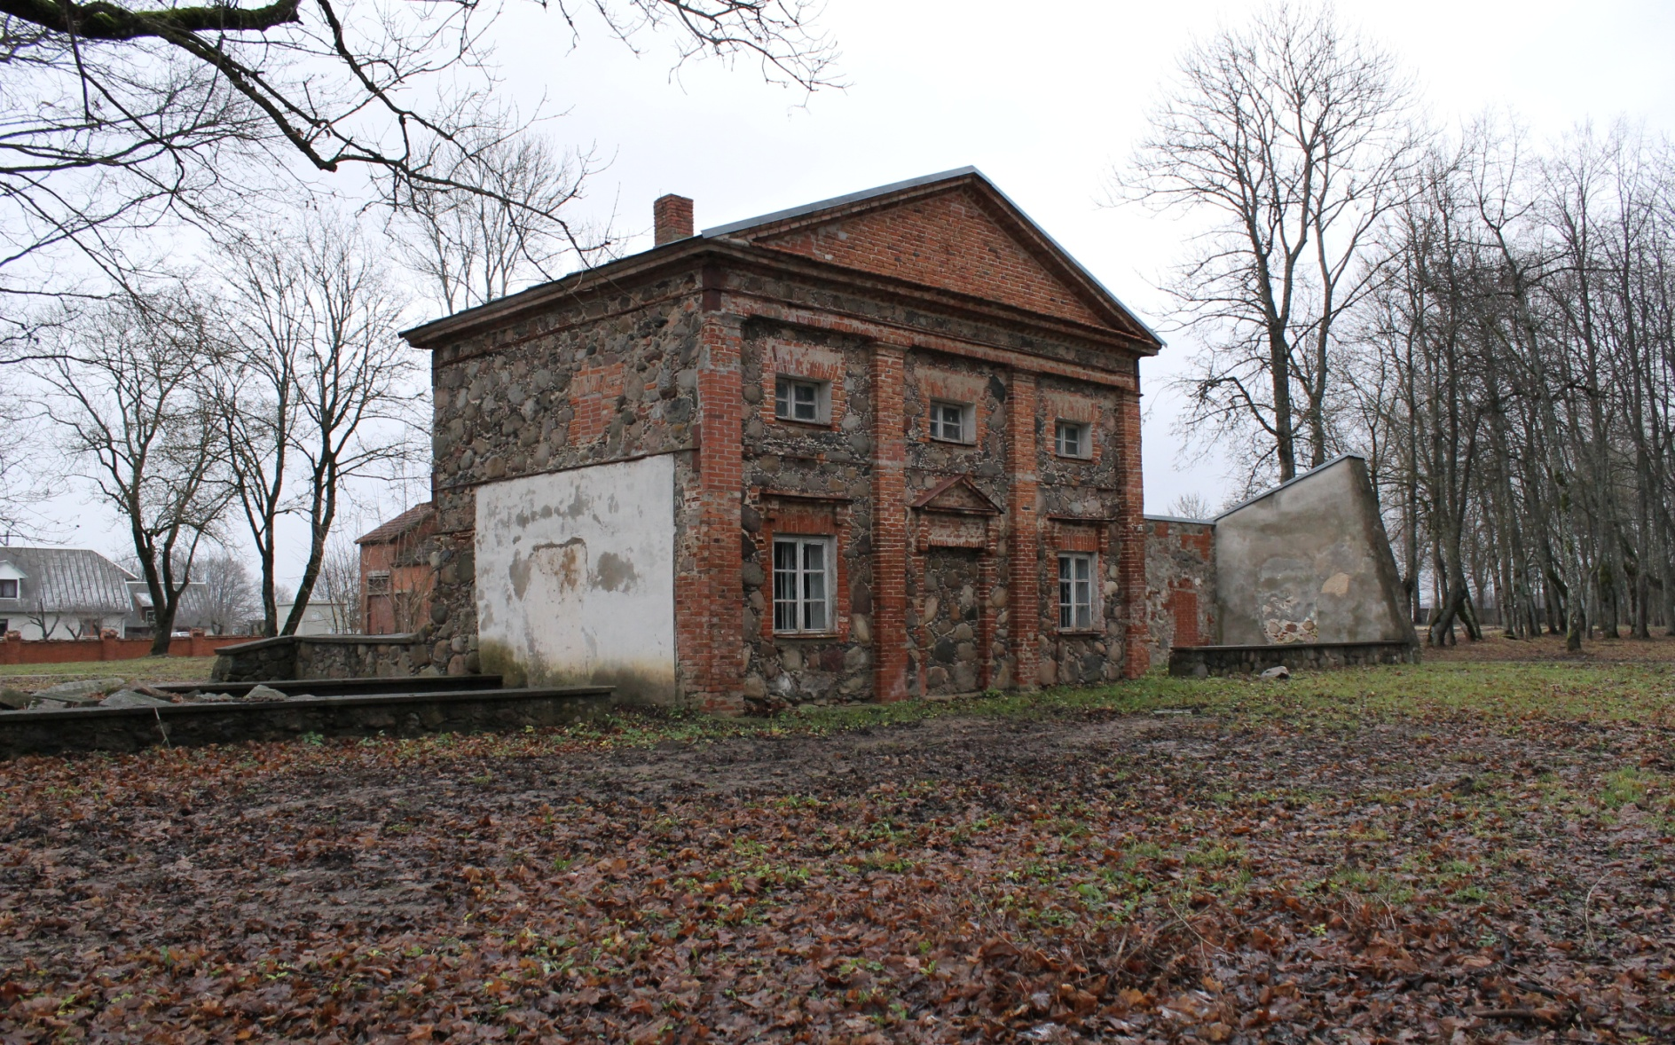
Reconstruction of orangery (49,56 sq.m) and adjustment to exposition of variable greenery and small architecture;

Slide 7
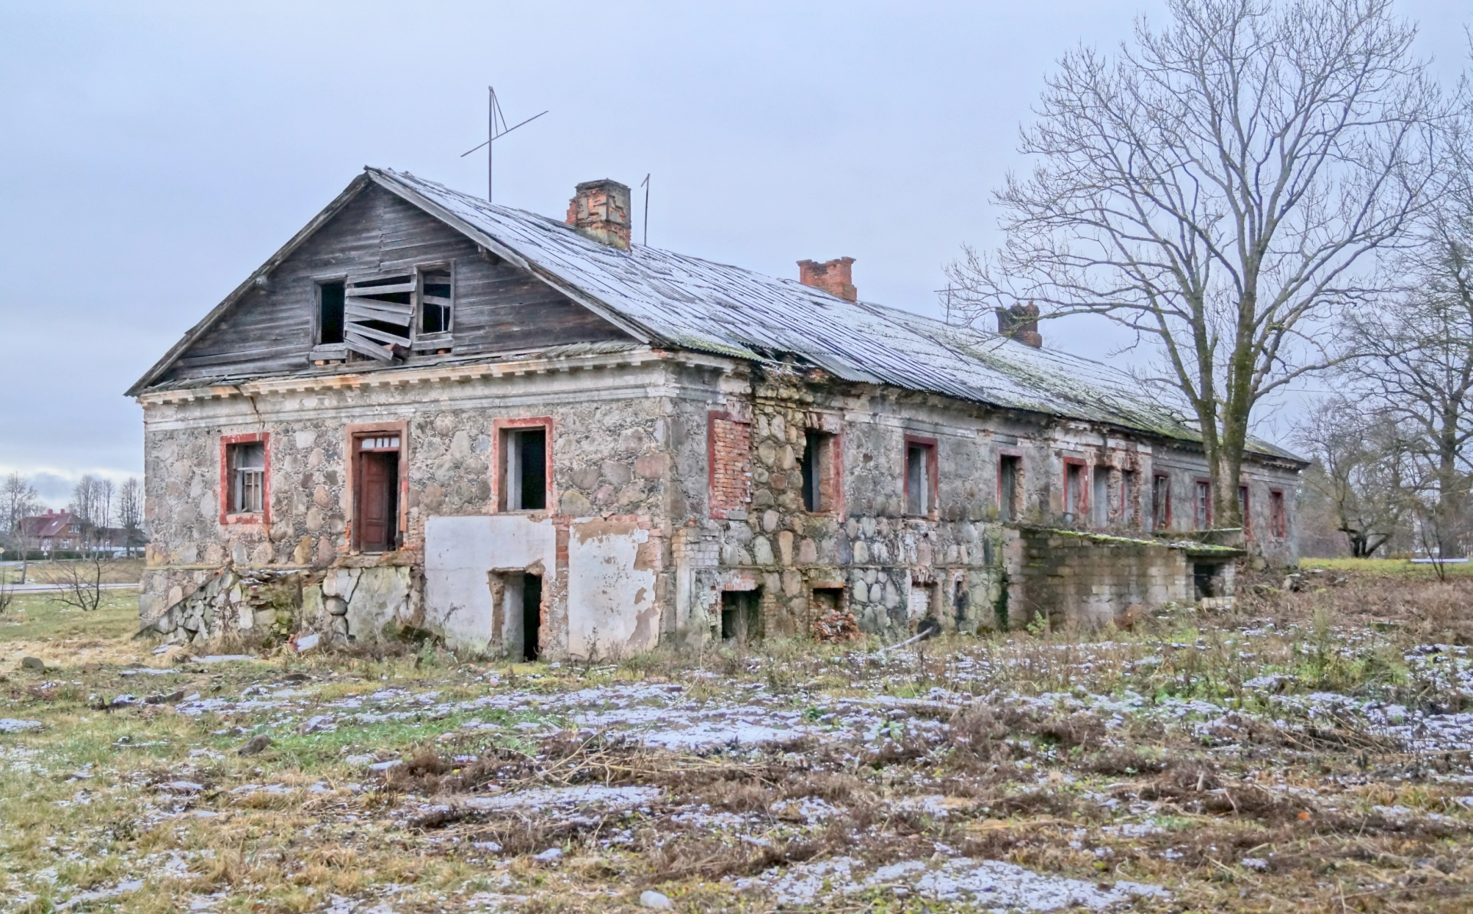
Reconstruction of housekeeper building (501,86 sq.m) and adjustment to the hotel;

Slide 8
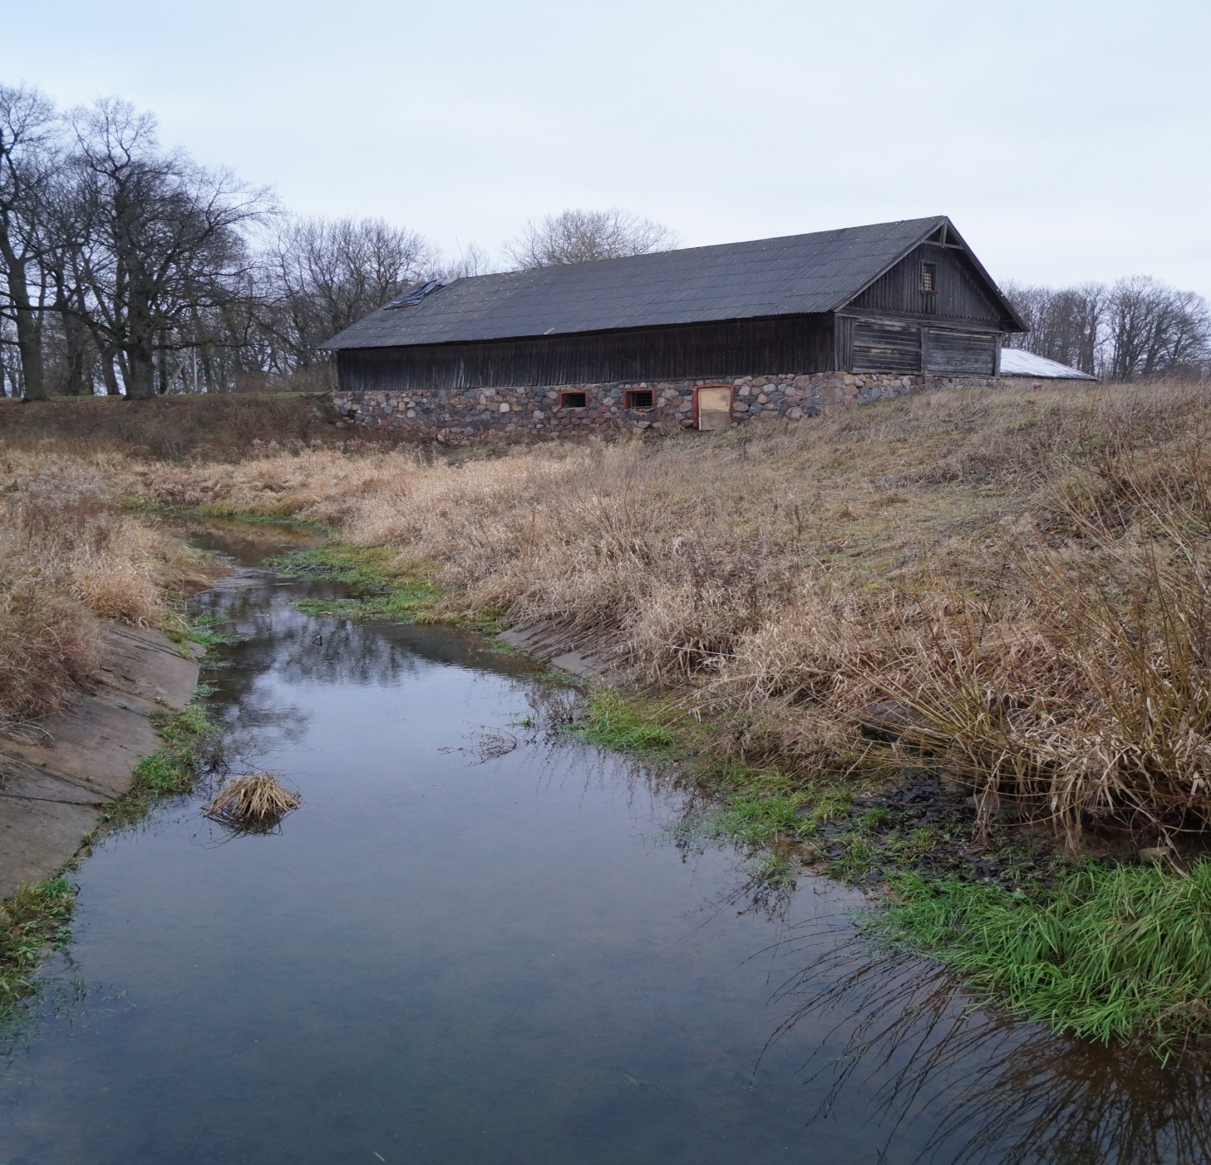
Reconstruction of the barn (216,34 sq.m) and adjustment to theatre, exposition of old crafts.

Slide 9
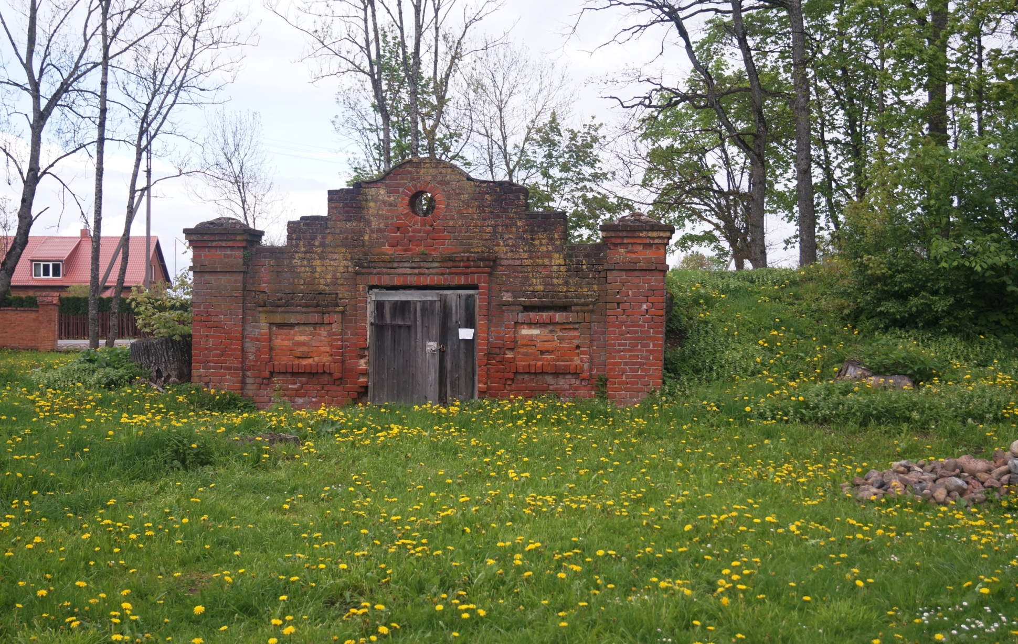
Reconstruction of cellars and adjustment to exposition of ceramics, pottery, educational room of lively crafts;

Slide 10
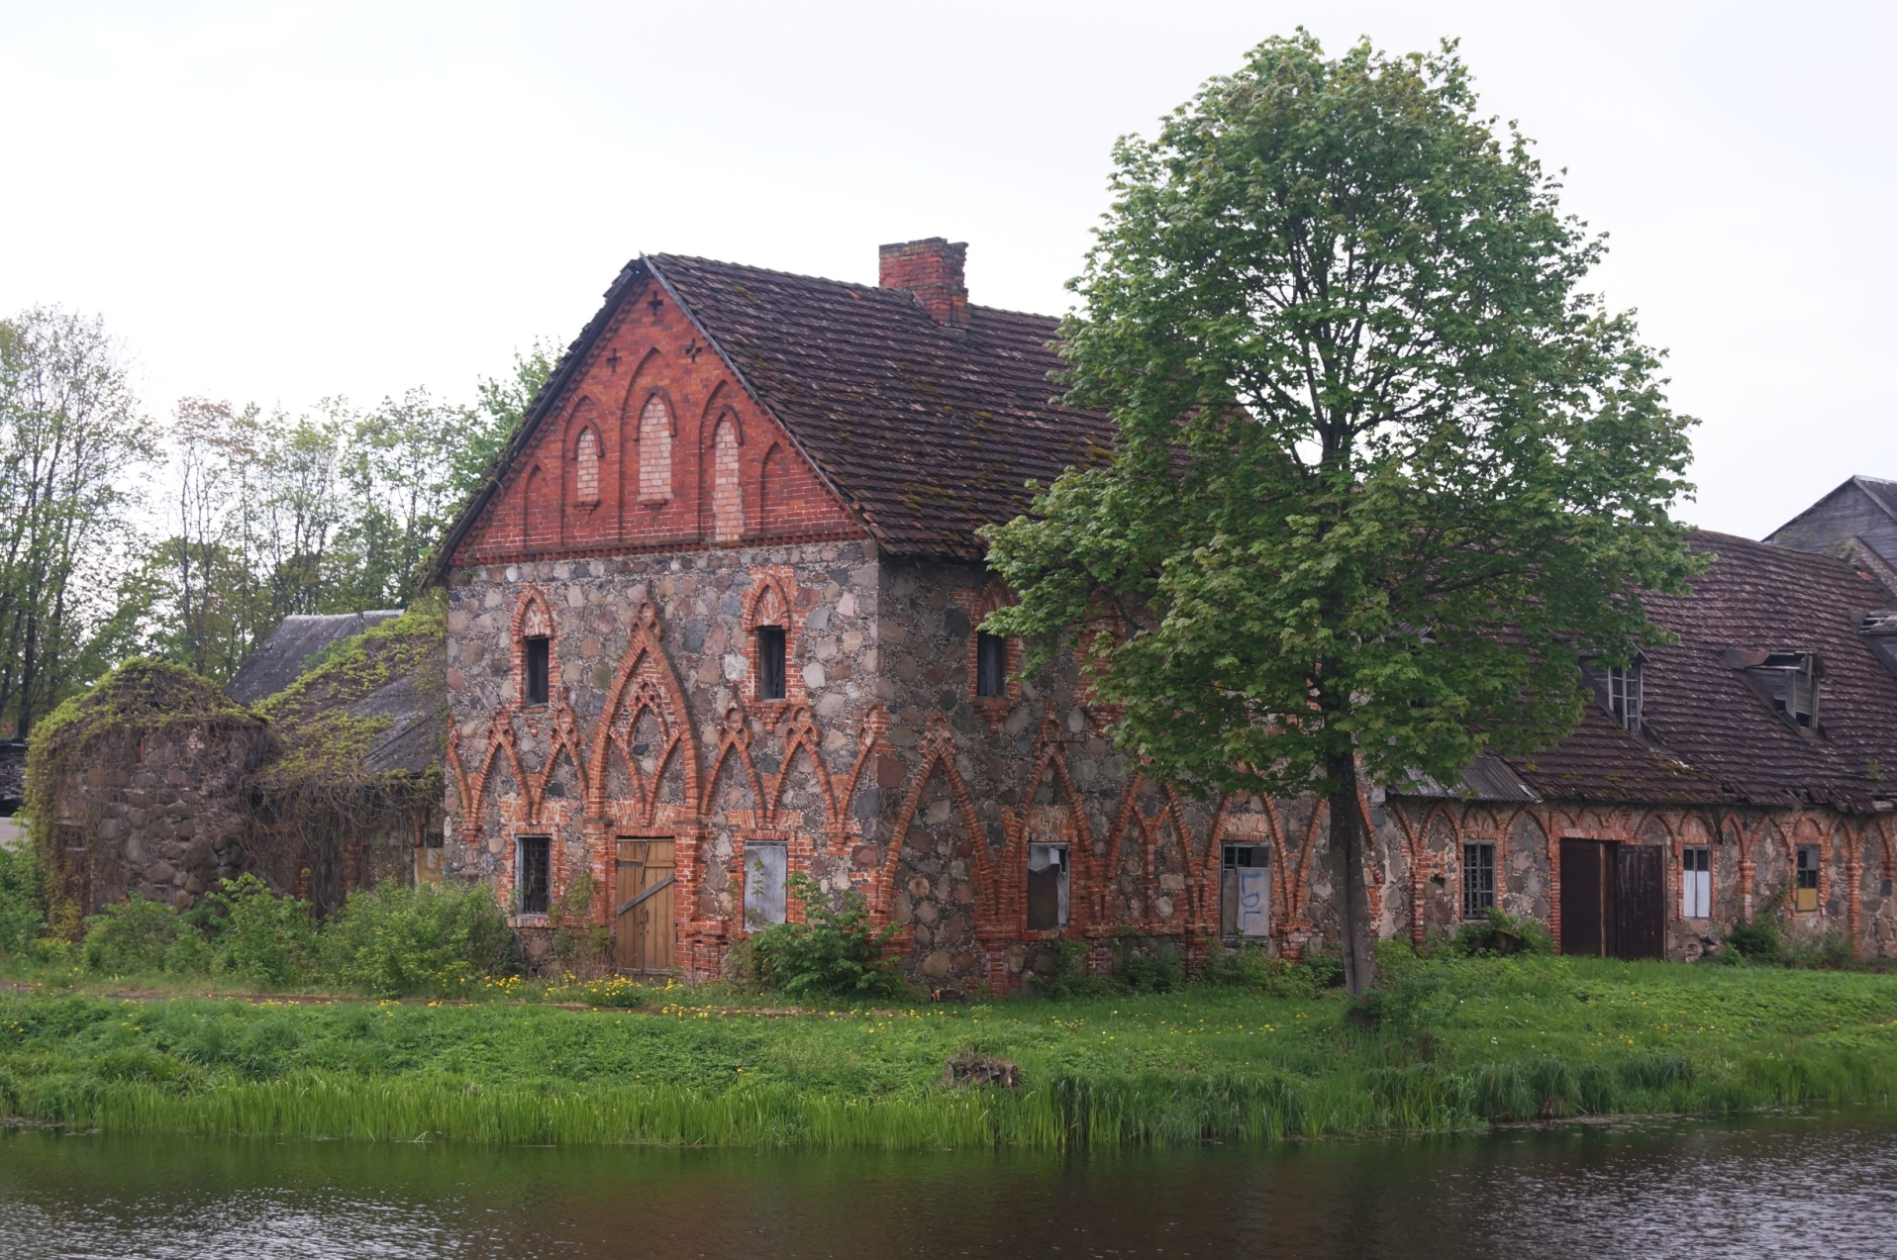
Castle of Krosinskiai. Technical documentation is not prepared, the total value of reconstruction is unknown.

Slide 11
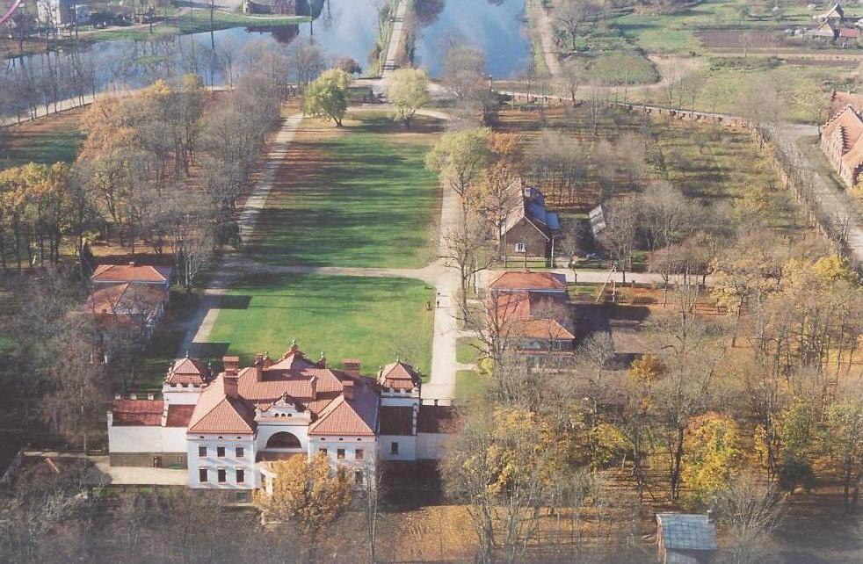
Restoration of the park of Rokiskis Manour House (installation of paths, restoration of fences, greenery, illumination of the territory, installation of drainage system, fencing of the territory, installation of children’s playgound, setting of small architecture), total area of the park – 32,01 hectares

Slide 12
For more detailed information about investment projects of Rokiskis District Municipality please contact:
Rokiskis District Municipality Administration Department of Strategic Planning and Investments
Respublikos str. 94, LT-42136 Rokiškis
phone.: 8 458 71407
email: verslas@post.rokiskis.lt
v.meciukoniene@post.rokiskis.lt

